Slide 1
ELECTRONIC FOOD AND AGRIC-PRODUCTS MARKET PLACE-
(E-FAMP)
AN ONLINE MARKET FOR AGRICULTURAL PRODUCTS

Slide 2

PROBLEM
Lack or ready market on farm produce
A great deal of our local population is linked to agriculture in one way or the other, and most depend on agribusiness for income and this income is affected negatively by post harvest losses
onClick={ buyAndSellAnywhere}

Slide 3

SOLUTION
BY AND SELL ANYWHERE
An increase in the use of electronic devices
Can enhances my idea of buy and sell anywhere.
onClick={ buyAndSellAnywhere}

Slide 4

ALLOW YOU TO BUY AND SELL ANYWHERE

Slide 5
HOW TO USE
REGISTER
For traceability
SIGN UP
SIGN IN AS A MEMBER
SIGN IN
Trade with members
UPLOAD A PRODUCT FOR SALE
UPLOAD PRODUCT
PUT WHAT YOU WANT TO SELL
PURCHASE
START TRADING AT YOUR OWN CONVENIENCE
BUY

Slide 6
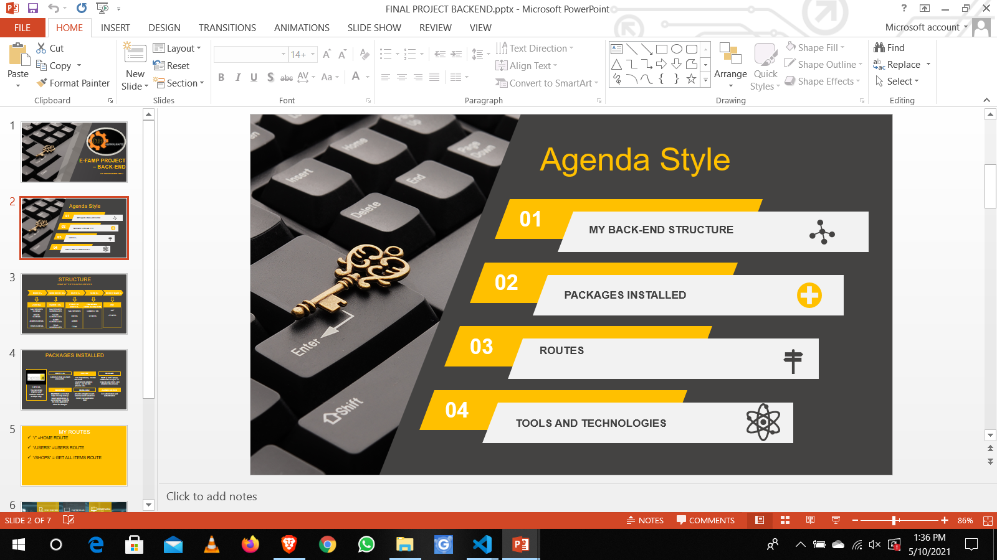
SERVER SIDE DEVELOPMENT
$62,000
Get a modern PowerPoint Presentation that is beautifully designed. I hope and I believe that this Template will your Time, Money and Reputation.

Slide 7
STRUCTURE
SOME OF THE FOLDERS CREATED
MODELS
CONTROLLERS
ROUTES
CONFIG
MIDDLEWARES
SCHEMA
USERS SCHEMA
ITEMS SCHEMA
HANDLERS
USERS CONTROLLER
ITEMS CONTROLLER
PROJECT ROUTES
USERS
ITEMS
DATABASE CONFIGURATION
CONNECT DB
OTHERS
bcriptjs
OTHERS

Slide 8

PACKAGES INSTALLED
BCRYPT JS
DOTENV
MORGAN
A library to help you hash passwords.
zero-dependency module that loads
environment variables
from a . env file into
process. env .
Node.js and Express
middleware to log HTTP
requests and errors, and simplifies the process
EXPRESS
You can simply impress your audience and add a unique zing.
NODEMON
MONGOOSE
nodemon is a tool that
helps develop node.js
based applications by
automatically restarting
the node application
when file changes
provides straight-forward, schema-based solution to model your application
data.

Slide 9



TEXT EDITOR
EXPRESS JS
THUDER
CLEINT
TOOLS AND TECHNOLOGIES EMPLOYED

Slide 10


APP INTEGRATION
MOVING FROM SERVER TO UI

Slide 11
REACTJS
REACTSTRAP AND REACT-BOOTSTRAP
REACT-ROUTER-DOM
REACT-ICONS
E- FAMP USER INTERFACE

Slide 12
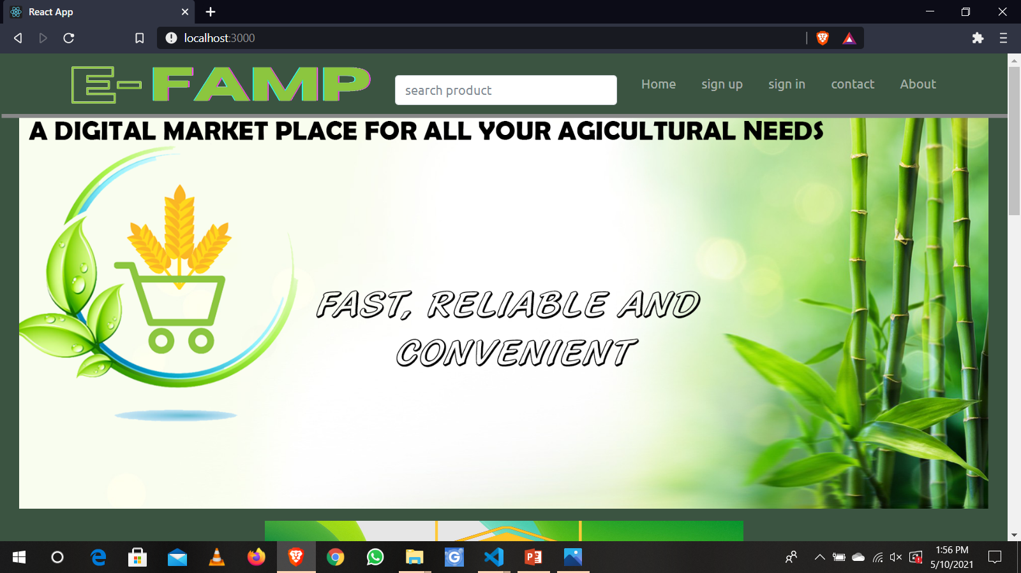
HOME PAGE

Slide 13
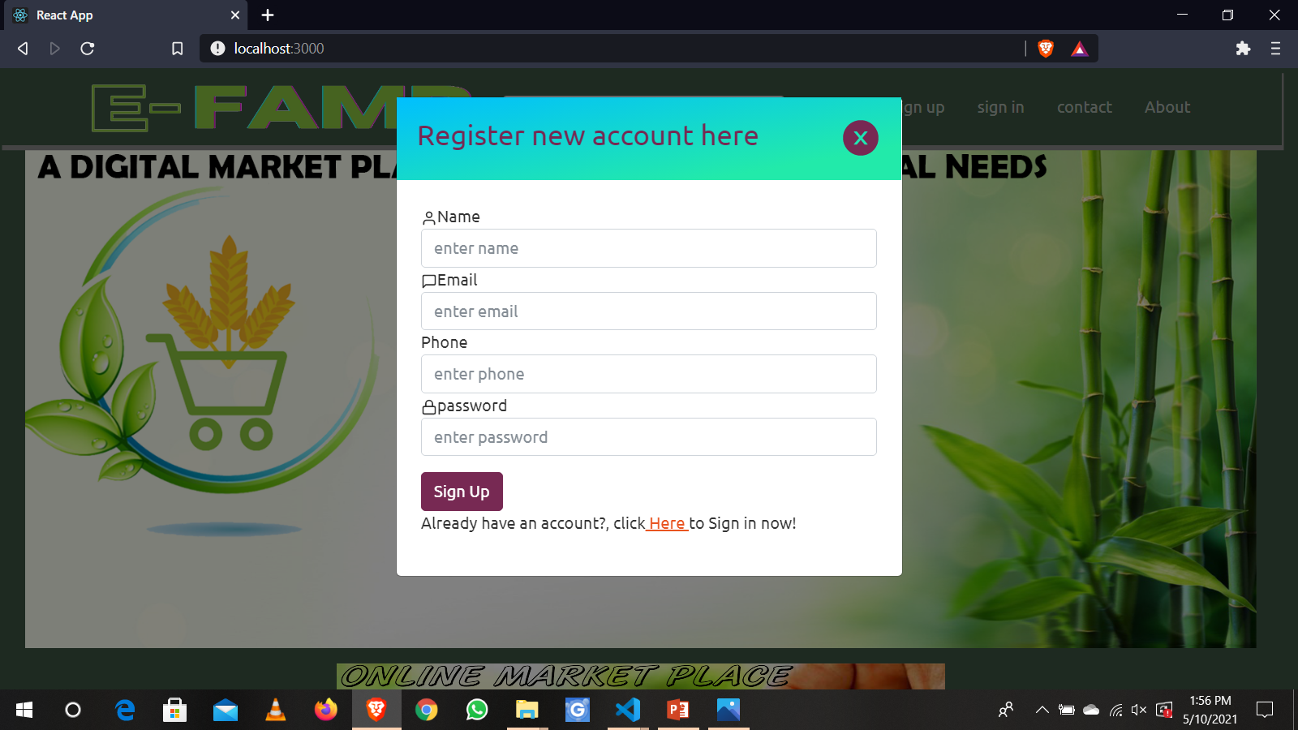
SIGN UP FORM (modal)

Slide 14
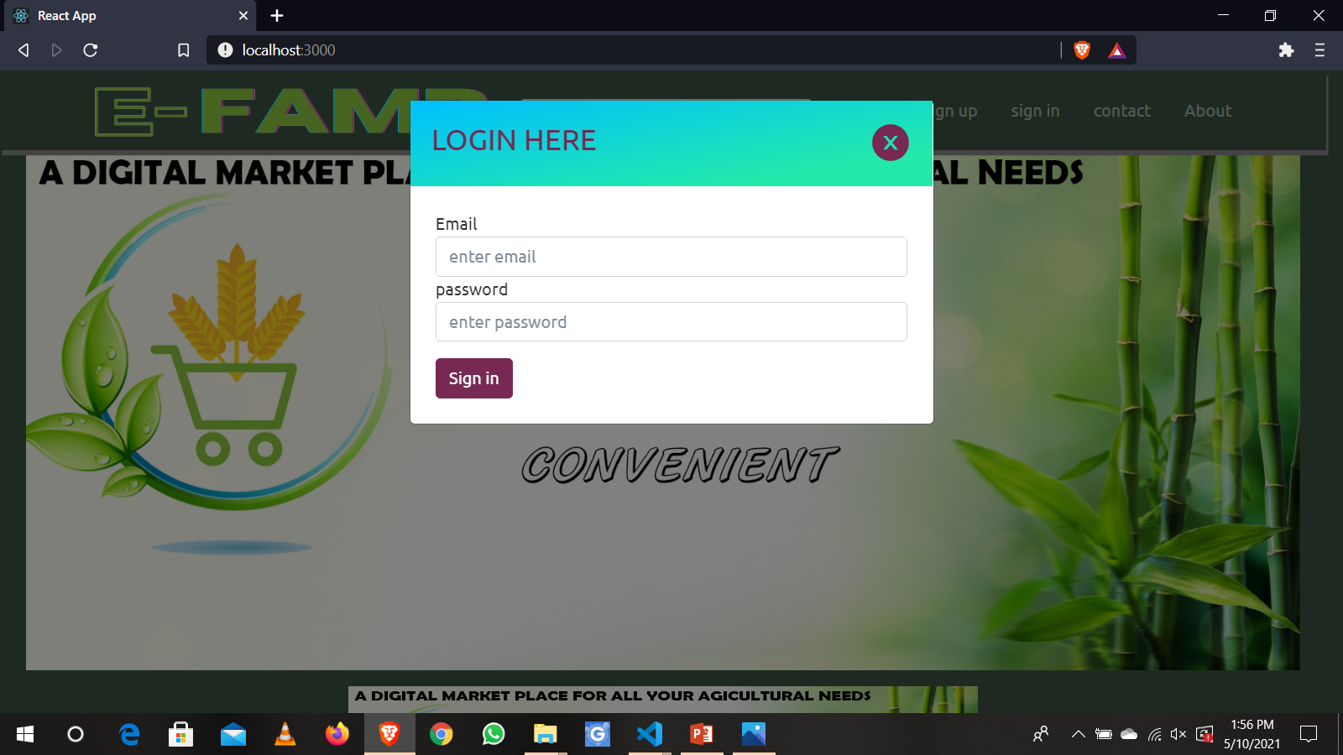
SIGN IN SCREEN

Slide 15
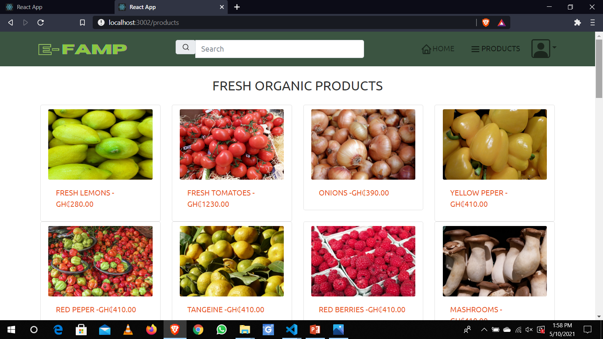
PRODUCTS SCREEN

Slide 16
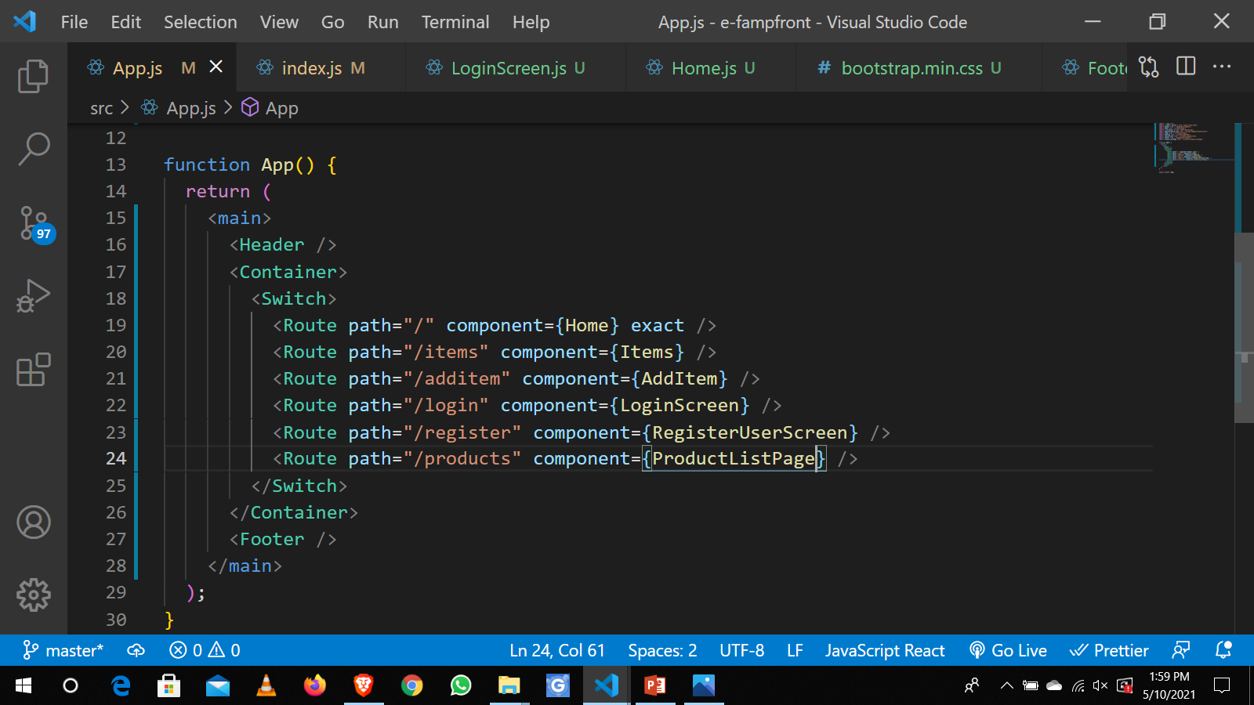
APP COMPONENT

Slide 17
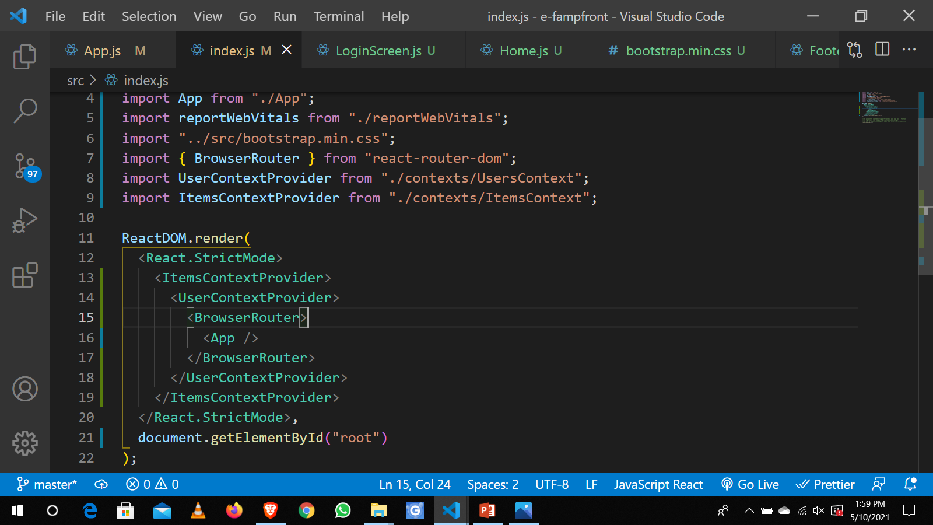
WRAPPING CONTEXT

Slide 18
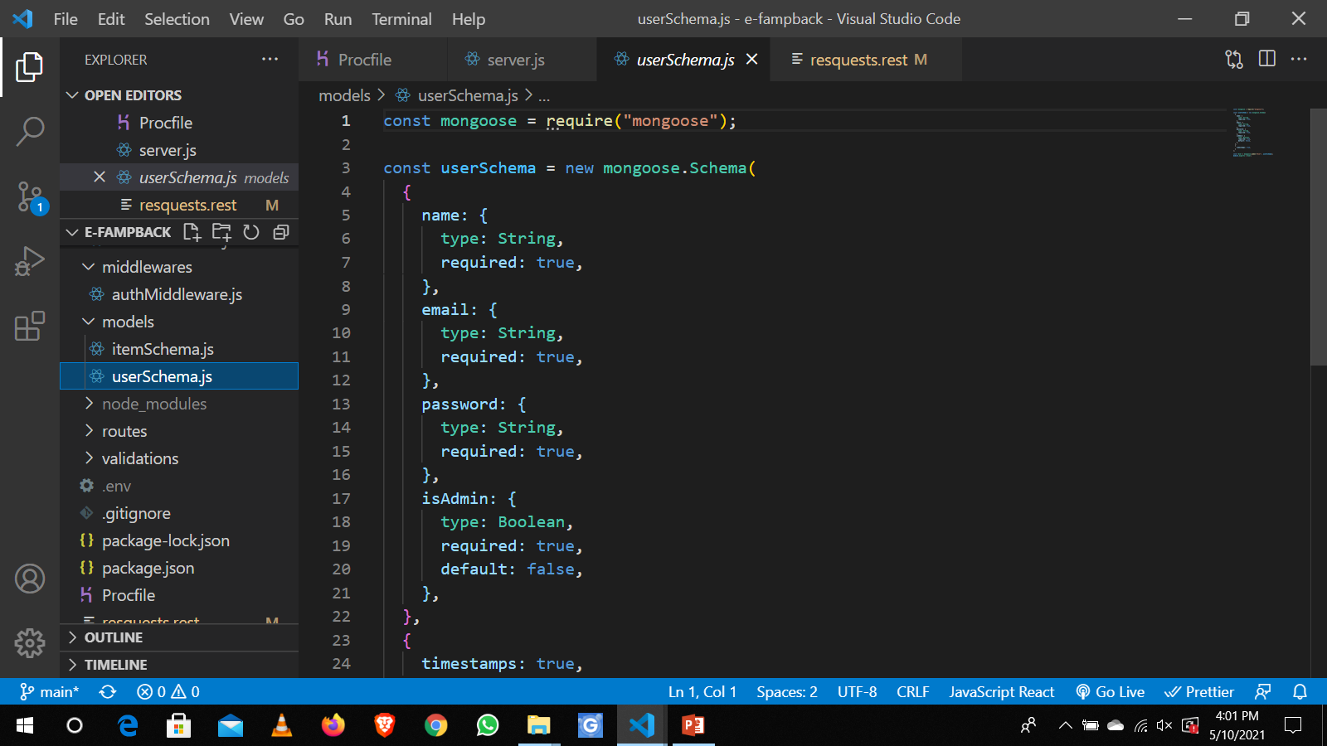
USERS MODEL

Slide 19
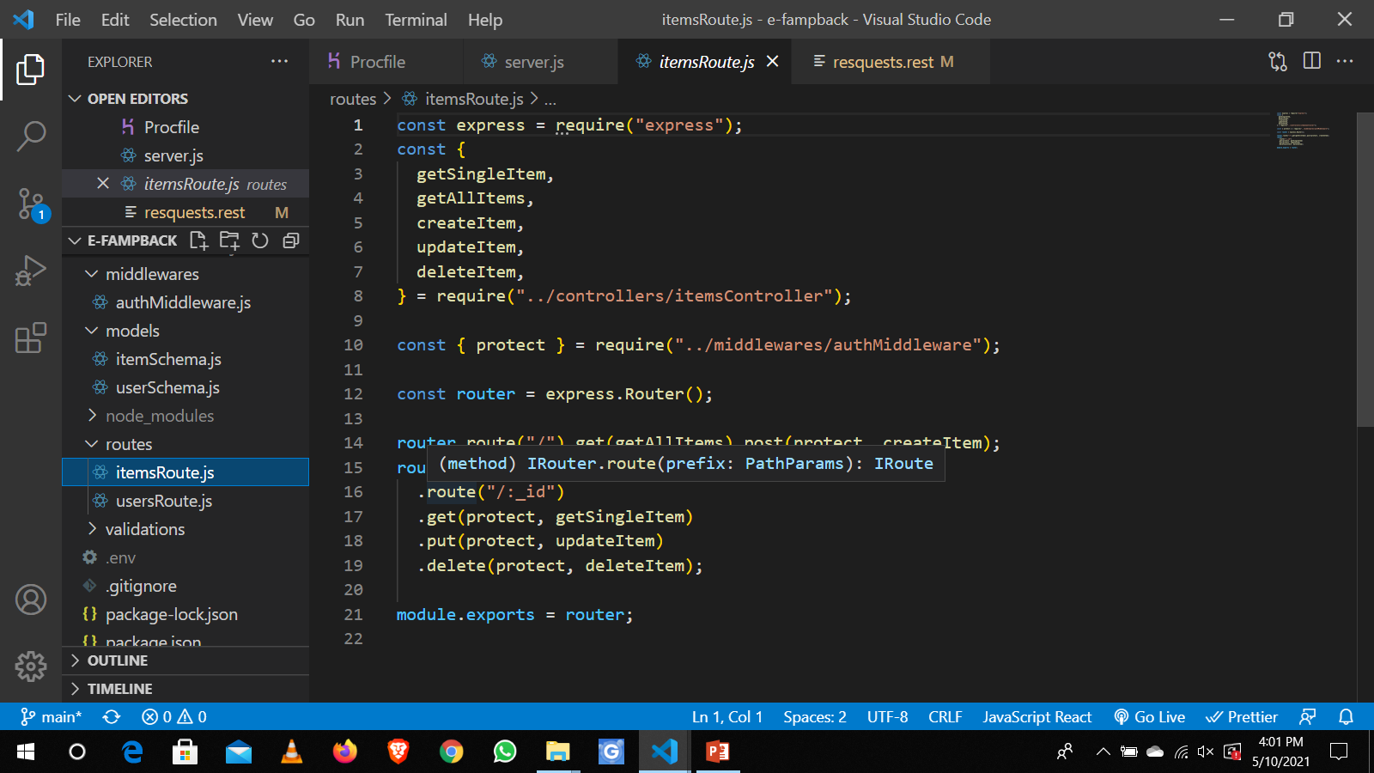
ROUTES

Slide 20
FUTURE OF
E-FAMP

Slide 21
CONTACT US
Aminu E-famp

Slide 22
THANK YOU
PRESENTATION BY DODOO HAFIZ

